Slide 1



STROKE DETECTION
Data Science for Innovation (36100)- Group 9
Deoyani Pareek (14371001)
Paras Sharma (24697397)
Sweety Gupta (24628505)

Slide 2

AGENDA
1 | Introduction- Problem
2 | Research Question
3 | Literature Review
4 | Methodology
5 | Data Prepocessing
6 | Exploratory Ananlysis
7 | Data Modelling
8 | Results and Conclusion

Slide 3

INTRODUCTION
Stroke is the second leading cause of death globally, following is chemicheart disease, according to the WHO in 2020.
Strokes occur when blood flow to the brain is abruptly interrupted, leading to cell death and varying degrees of disability.
Annually, 15 million people suffer from strokes, resulting in 5 million deaths and 5 million cases of permanent disability, placing a significant strain on families and public health systems.
Our research aims to develop precise machine learning models to predict stroke risk based on lifestyle and health data, enabling early intervention and prevention.

Slide 4

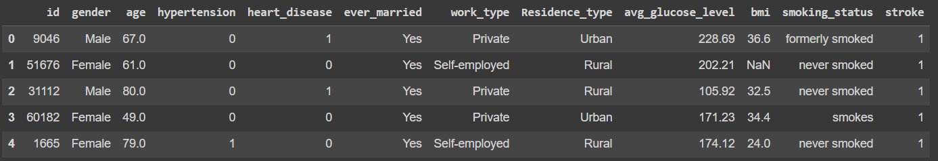
DATASET OVERVIEW
Number of Patients: 5110
Number of Features: 12

Slide 5

RESEARCH QUESTION
How do various factors such as age, work type, marital status, residential type, smoking status, and BMI influence the risk of having a stroke, and how can these factors be integrated into a machine learning model to accurately predict stroke occurrence?
Null Hypothesis & Alternative Hypothesis
H0: Factors such as age, work type, marital status, residential type, smoking status, and BMI do not significantly influence the risk of having a stroke.
H1: Factors such as age, work type, marital status, residential type, smoking status, and BMI significantly influence the risk of having a stroke.

Slide 6
LITERATURE REVIEW
We reviewed following independent papers that have tried solving the similar problem with different datasets using Machine Learning Models
01
02
03
04
A comparative analysis of machine learning classifiers for stroke prediction: A predictive analytics approach by Nitish Biswas, Khandaker Mohammad Mohi Uddin , Sarreha Tasmin Rikta and Samrat Kumar Dey
A predictive analytics approach for stroke prediction using machine learning and neural
networks by Soumyabrata Dev , Hewei Wang , Chidozie Shamrock Nwosu , Nishtha Jain , Bharadwaj
Veeravalli and Deepu John
Predicting Risk of Stroke From Lab Tests Using Machine Learning Algorithms: Development and
Evaluation of Prediction Models by Eman M Alanazi, Aalaa Abdou and Jake Luo
Stroke Risk Prediction with Machine Learning Techniques by Elias Dritsas and Maria Trigka

Slide 7


OBJECTIVES
Find major health/lifestyle indicators that can predict stroke
Create a model that will accurately predict the possibility of stroke

Slide 8

Data Acquistion
Acquried the dataset from Kaggle with 5110 rows & 12 features
01
Data Cleaning & Preprocessing
Missing values present in ‘bmi’ column. Built a simple linear regression model to fill out the missing values
02
DATA PROCESSING METHODOLOGY
03
Data Transformation
Applied Label Encoding & One-hot encoding for categorcial variables, viable for data modelling
Exploratory Analysis
Utilised Matplotlib & Seaborn to explore Target Variable & other variable of interests, likelihood to stroke.
04
Data Modelling
Applied classification models, including Logistic Regression, SVM, RFC, and ETC, to predict stroke likelihood.
05

Slide 9


EXPLORATORY ANALYSIS

Slide 10
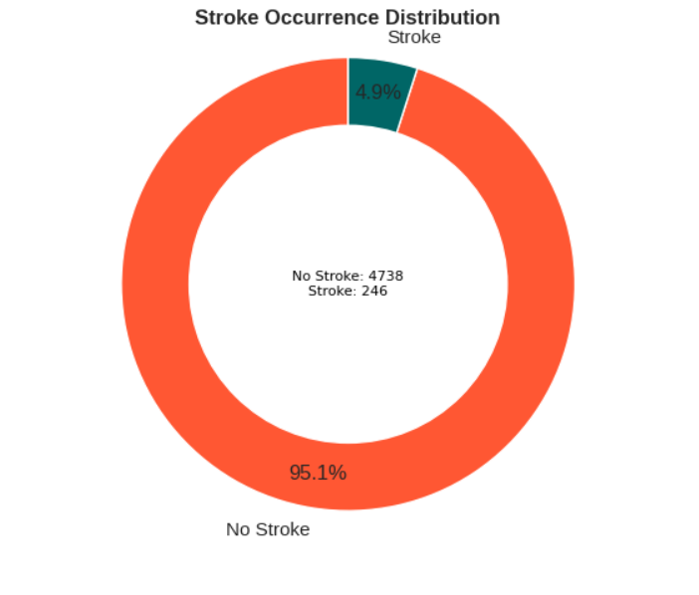
TARGET VARIABLE DISTRIBUTION
The pie chart demonstrates that 4.9% (249) of patients in our dataset have experienced a stroke.
This relatively low prevalence of stroke, at 4.9%, highlights the importance of early detection and prevention strategies despite the condition's seemingly low occurrence.
Class imbalance is evident, with stroke cases at 4.9%. This can negatively impact ML models, so oversampling will be used to address this issue.

Slide 11
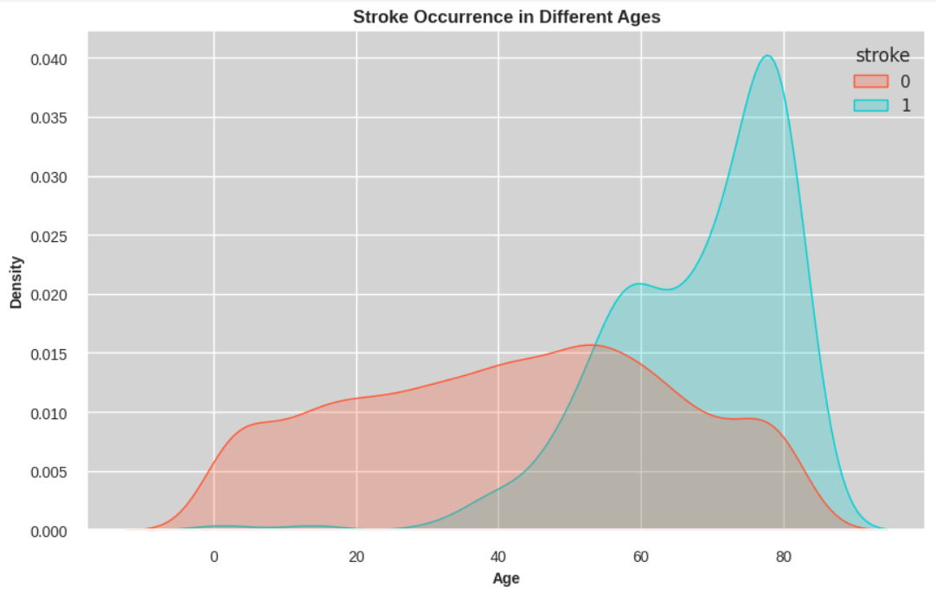
STROKE OCCURENCE BY AGE
We observe that the incidence of stroke cases starts to increase significantly from around age 25. This upward trend continues progressively, reaching its peak around the age of 80. This pattern suggests that age is a critical factor in stroke risk, with the likelihood of experiencing a stroke growing as individuals advance in age.
This analysis underscores the need for targeted preventive measures and interventions, especially for individuals entering their mid-twenties and beyond, to manage and mitigate the risk factors associated with stroke.

Slide 12
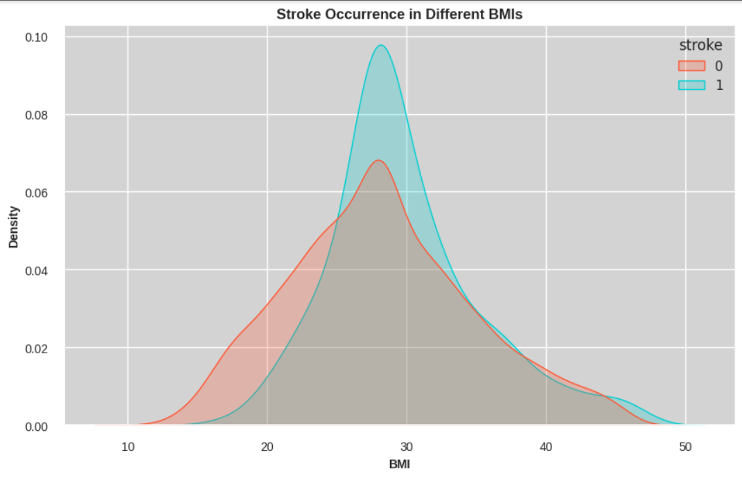
STROKE OCCURENCE BY BMI
The visualization reveals a clear trend indicating that the majority of stroke cases are found in individuals with a BMI of approximately 28 or higher, which falls into the obese category. This suggests a strong correlation between higher BMI and the risk of stroke.

Slide 13
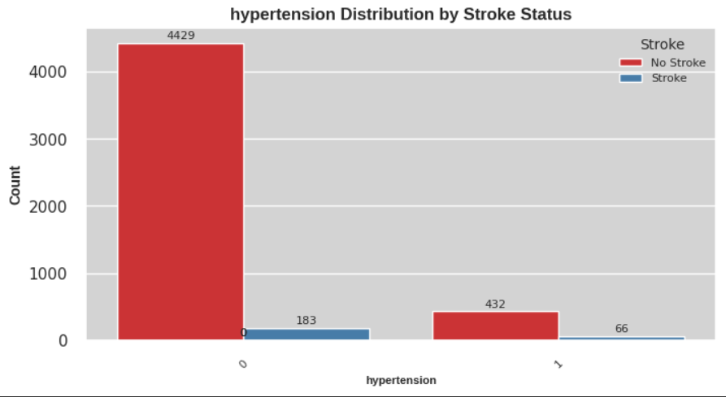
STROKE OCCURENCE BY HYPERTENSION
Despite the class imbalance in our dataset, it seems that hypertension may not have a substantial impact on the likelihood of experiencing a stroke. Interestingly, we observe a lower incidence of stroke cases among individuals with hypertension.

Slide 14
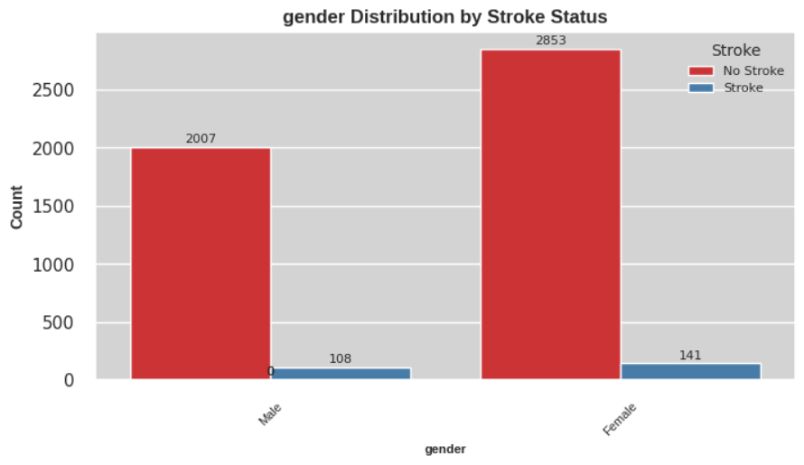
STROKE OCCURENCE BY GENDER
Given that our dataset predominantly comprises information about female patients, we can note that the occurrence of stroke is approximately 5% for both genders.

Slide 15
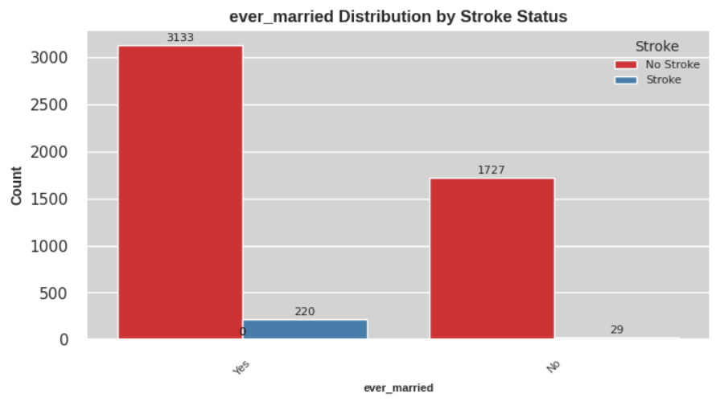
STROKE OCCURENCE BY MARITAL STATUS
Based on the plot, it is evident that both married men and women exhibit a higher likelihood of experiencing a stroke. This trend is particularly pronounced among unmarried males. Furthermore, married women appear to have a higher incidence of stroke compared to married men.

Slide 16
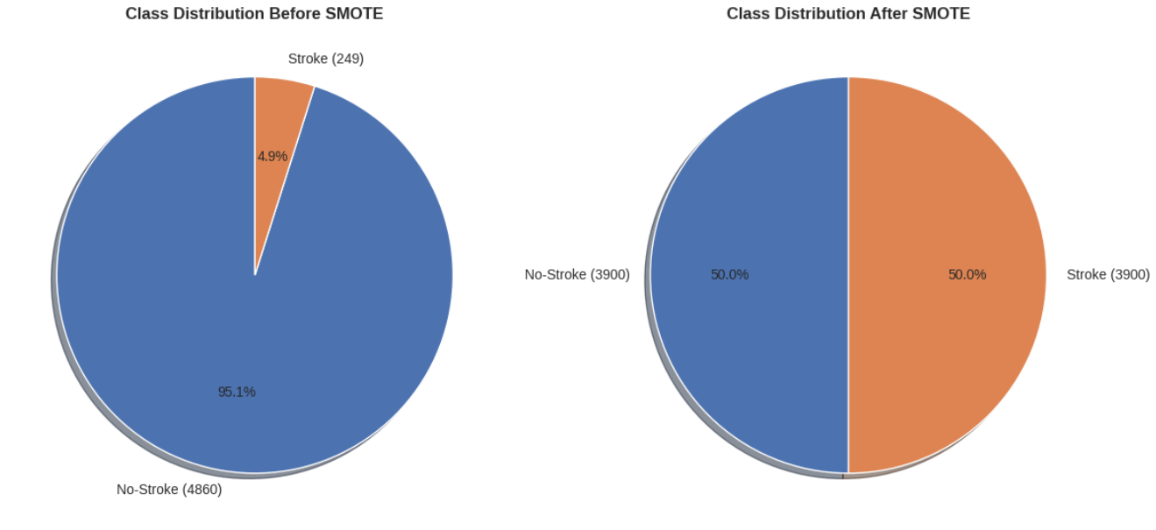
SMOTE- SYNTHETIC MINORITY OVER-SAMPLING TECHNIQUE
SMOTE (Synthetic Minority Over-sampling Technique) was applied to address the class imbalance in the dataset.
By generating synthetic samples for the minority class, SMOTE effectively rebalances the dataset.

Slide 17
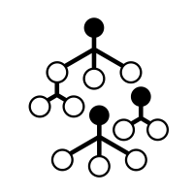



DATA MODELLING
Logistic Regression
Support Vector Machine
Random Forest Classifier
Extra Trees Classifier
The logistic regression model predicts stroke likelihood by fitting a logistic function to the selected independent variables, minimizing the log-likelihood.
SVM predicts stroke likelihood by finding the optimal hyperplane that maximizes the margin between classes based on selected independent variables.
RFC predicts stroke likelihood by constructing multiple decision trees and combining their predictions through ensemble learning, based on selected independent variables.
ETC predicts stroke likelihood by constructing multiple decision trees and combining their predictions through ensemble learning, based on selected independent variables.

Slide 18
HYPERMETER TUNING
GRIDSEARCH CV
Conducts an exhaustive search over a specified parameter grid to find the best hyperparameters.
GRIDSEARCH CV
Randomly samples hyperparameter combinations for efficient exploration of large parameter spaces, often finding near-optimal solutions with less computational cost.
RANDOMIZEDSEARCH
CV

Slide 19




QUANTIFYING RELIABILITY AND MEASURING EFFECTIVENESS
Recall
Precision
F1- Score
ROC Curve

Slide 20
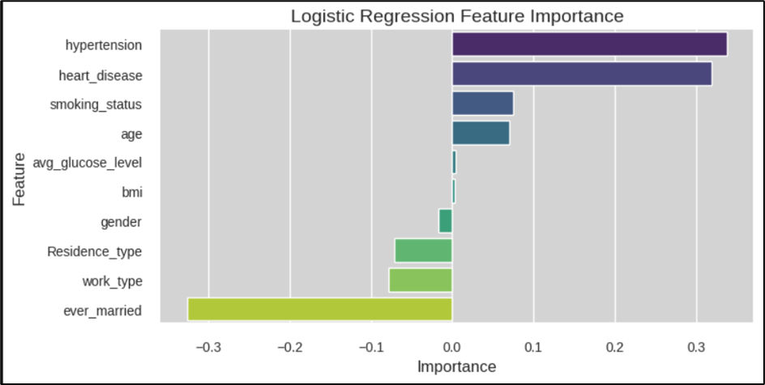
FEATURE IMPORTANCE CHART

Slide 21
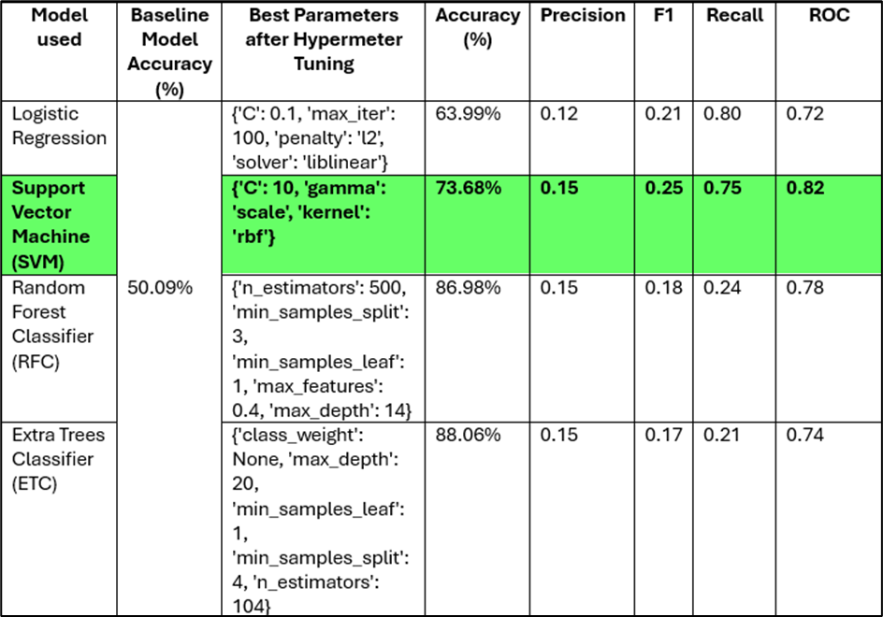
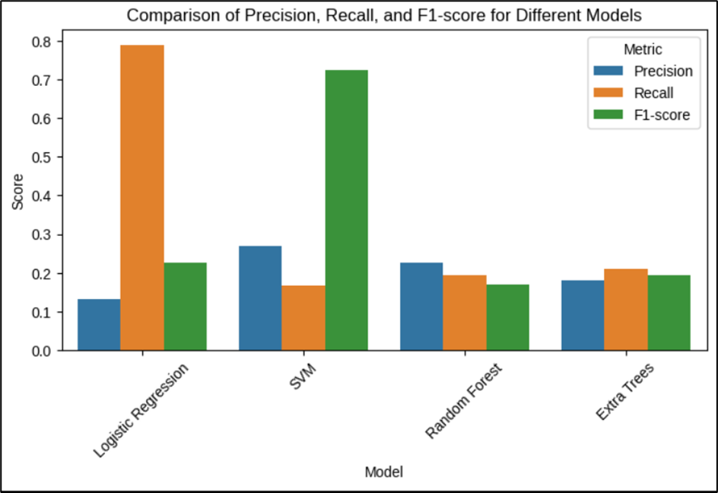
RESULTS & PERFORMANCE ANALYSIS

Slide 22

CONCLUSION
Based on the detailed performance metrics, the Support Vector Machine (SVM) emerges as the best model for analysis of stroke prediction. It offers a strong balance between accuracy (73.68%), precision (0.15), recall (0.75), F1 score (0.25), and the highest ROC score (0.82)
Data quality issues impact reliability. Implementing rigorous cleaning and input-checking protocols is essential for accuracy.
The challenge of class imbalance affects stroke case detection. Utilizing SMOTE and cost-sensitive learning can enhance model performance.
Further exploration of feature engineering techniques could lead to the
creation of more informative features.
DATA QUALITY AND COMPLETENESS
CLASS IMBALANCE
FEATURE ENGINEERING

Slide 23
THANK YOU

